Slide 1



Enhancing Sales, Profits & Analyzing Shopping Trends at Sri MahaLakshmi General Store
IIT Madras, BS degree
A Presentation for the BDM capstone Project
~ NandanReddy Parnapalli
22f3002857

Slide 2

Agenda
About Sri MahaLakshmi Stores
Overview of collected Data
Identified challenges
Analysis of challenge
Interpretation of results
Proposed solutions
Conclusion

Slide 3

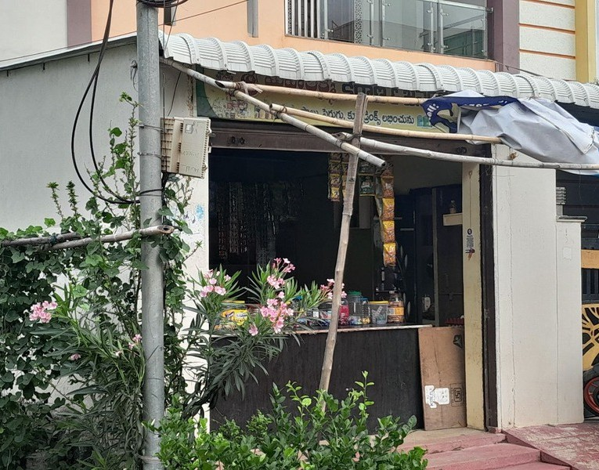
Sri MahaLakshmi Store
Sri MahaLakshmi General Stores, situated in Shiva Sai Ram Nagar Colony, Munganoor,
Hyderabad, Telangana 501511, has established itself over the past two years as
a cornerstone of the local community. Renowned for its comprehensive selection of essential products and services, the store caters to the diverse needs of its customers. It offers a vast array of provisions, including household goods, toiletries, sanitary items, groceries, daily essentials, beverages, and more. The store's commitment to quality and customer satisfaction has earned it the unwavering trust and loyalty of the local residents. Regular patrons
consistently choose Sri MahaLakshmi General Stores for their daily necessities, appreciating the convenience and reliability it offers.

Slide 4



Identified Challenges
Lack of Understanding in Customer Preferences
Overstocking and Understocking
Inaccurate Demand Forecasting

Slide 5
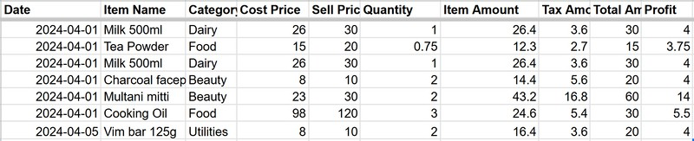
Collected data:
How to Enhance Sales, Profit & Analyze Shoping Trends at Sri MahaLakshmi General Store?

Slide 6
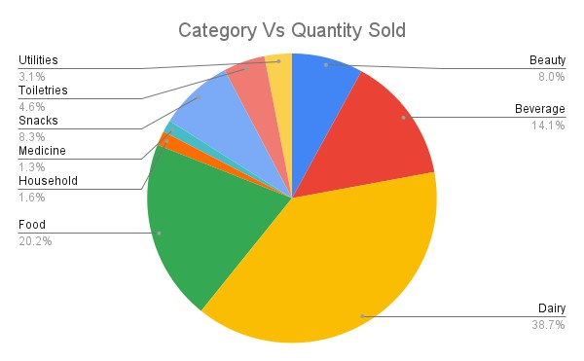
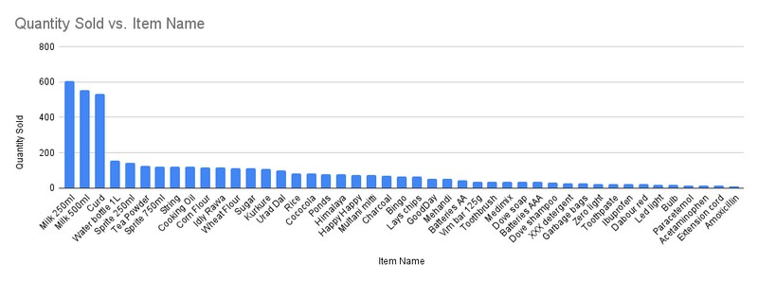
Interpretation of results

Slide 7

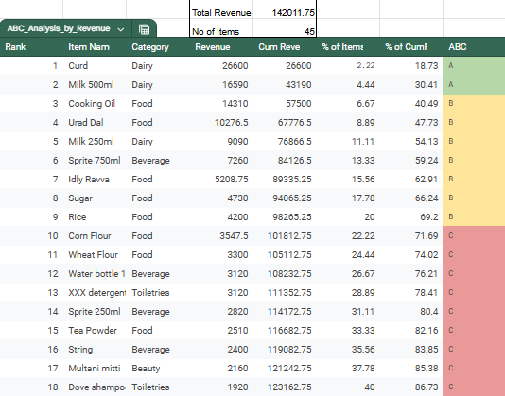
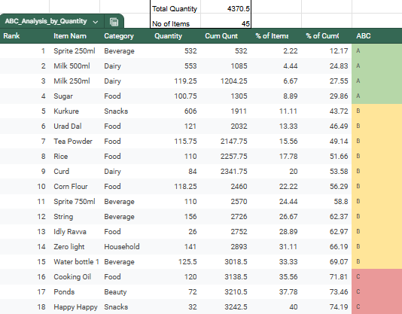
ABC Analysis

Slide 8
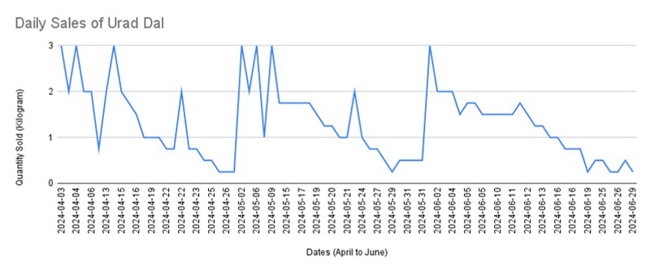
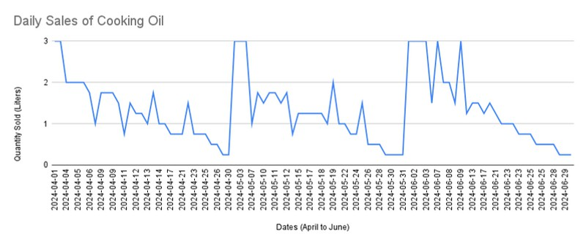
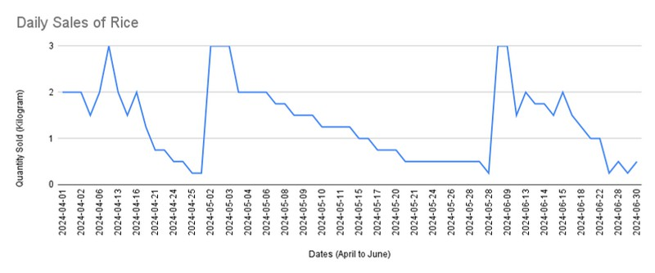
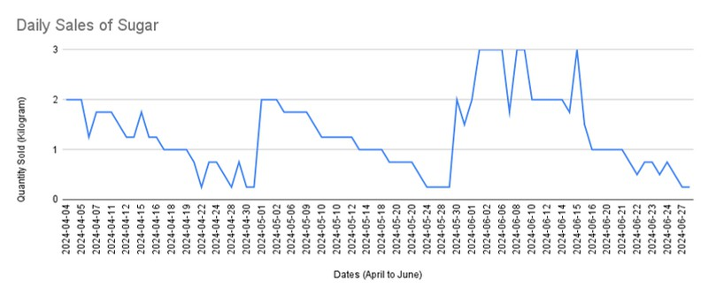
Time Series Analysis

Slide 9

Proposed solutions
Always maintain customers most preferring items.
Prefer selling items with high revenue.
Get rid of old stock by giving offers and discounts.
Maintain stocks according to the demand.
Leverage the use of WhatsApp Business to reach a broader audience in the area at a lower cost.
Maintain business data.

Slide 10







Thankyou

